Slide 1

Executive Summary
A Review of Airline Safety
By: Kimberly Cable

Slide 2
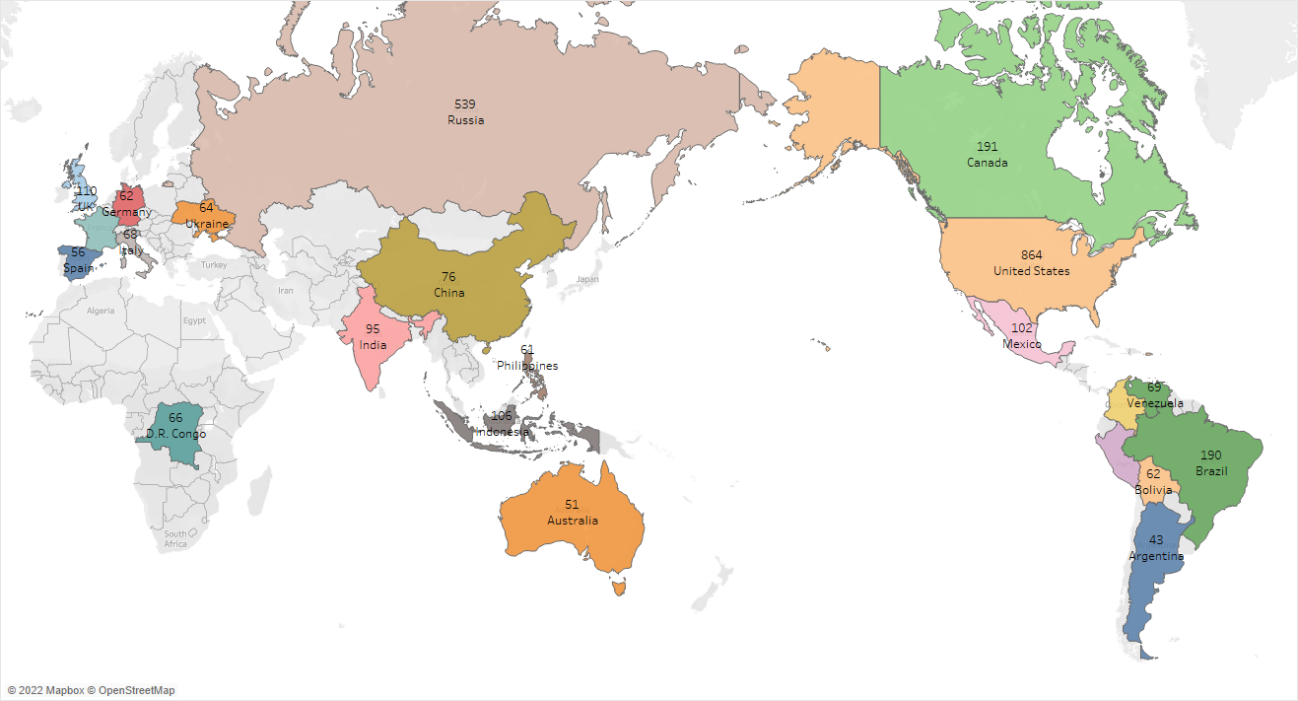
Countries with the highest number of fatal civil airliner accidents from 1945 – 2/28/ 2022

Slide 3
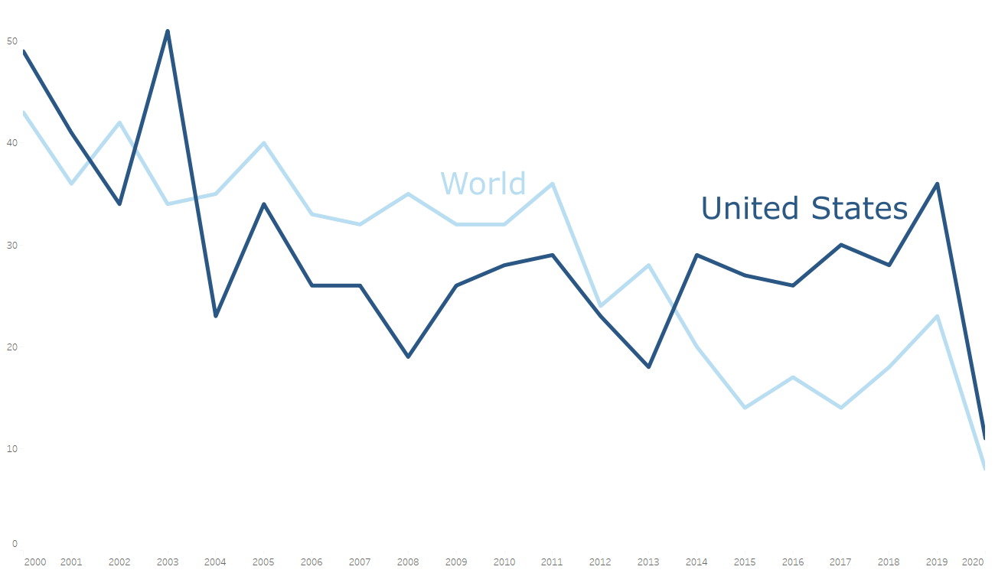
Airline Accidents from 2000 - 2020
These numbers do not include suicides, sabotages, hijackings, etc.

Slide 4
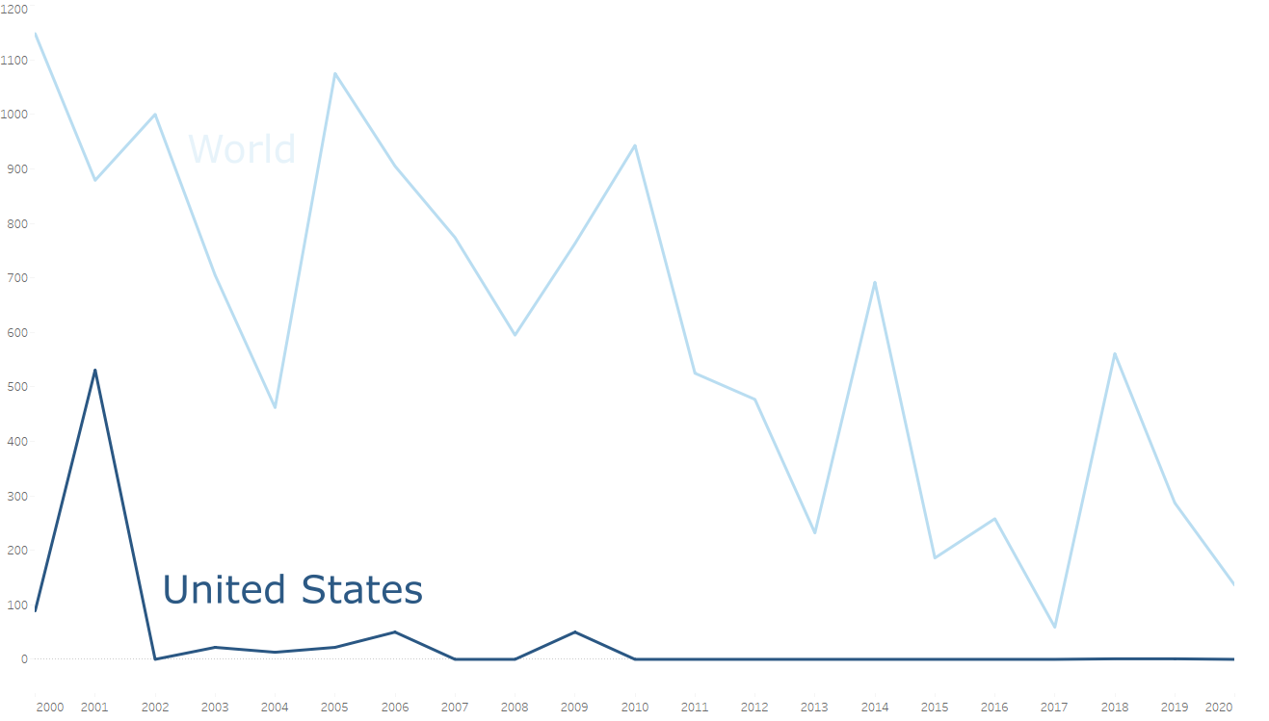
Airline Fatalities from 2000 - 2020
These numbers do not include suicides, sabotages, hijackings, etc.

Slide 5
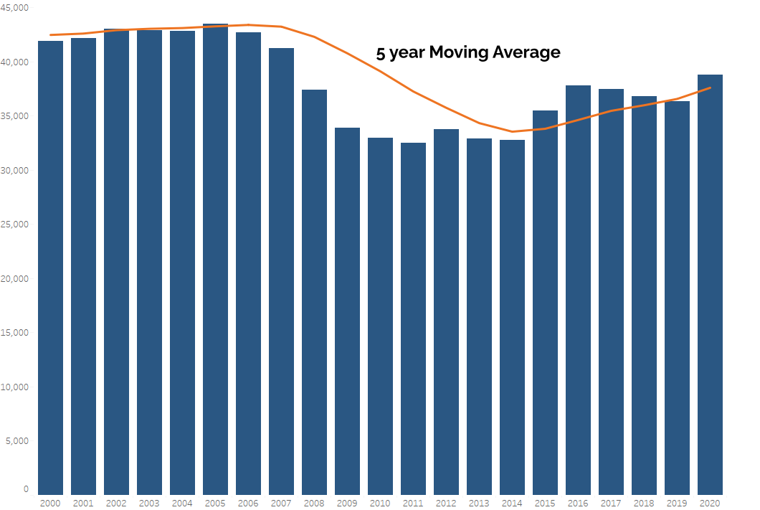
U.S. Vehicle Fatalities from 2000 - 2020

Slide 6
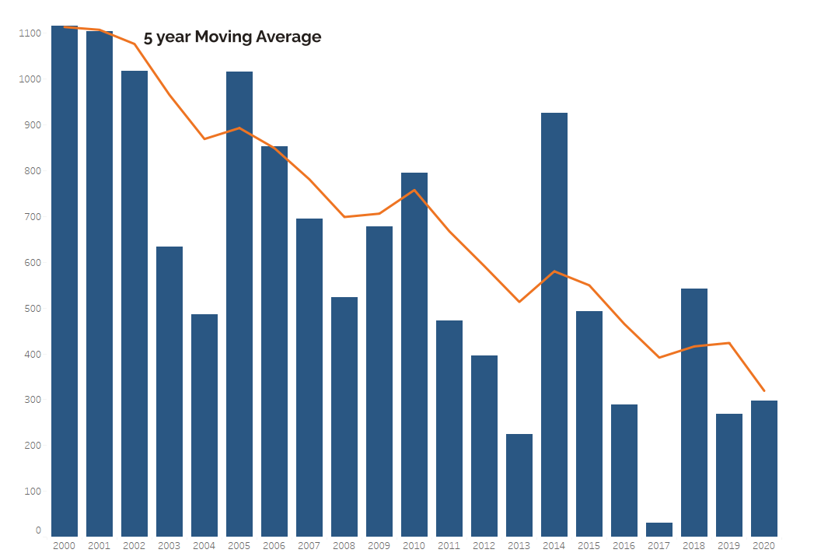
U.S. Passenger Plane Fatalities from 2000 - 2020
These numbers include suicides, sabotages, hijackings, etc.

Slide 7
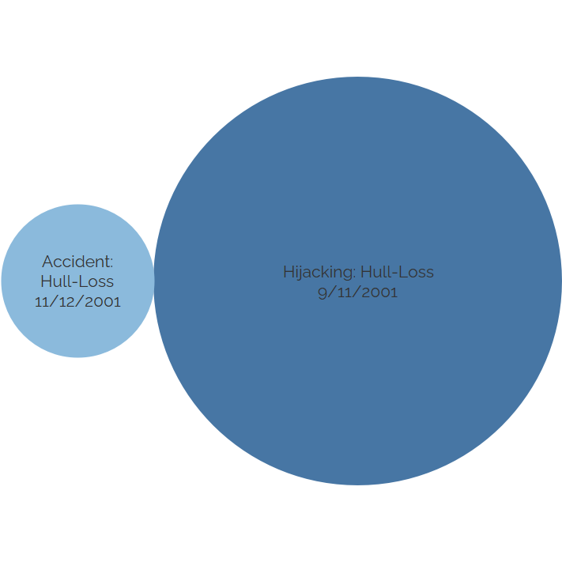
American Airlines Accidents and Fatalities from 2000 - 2020

Slide 8
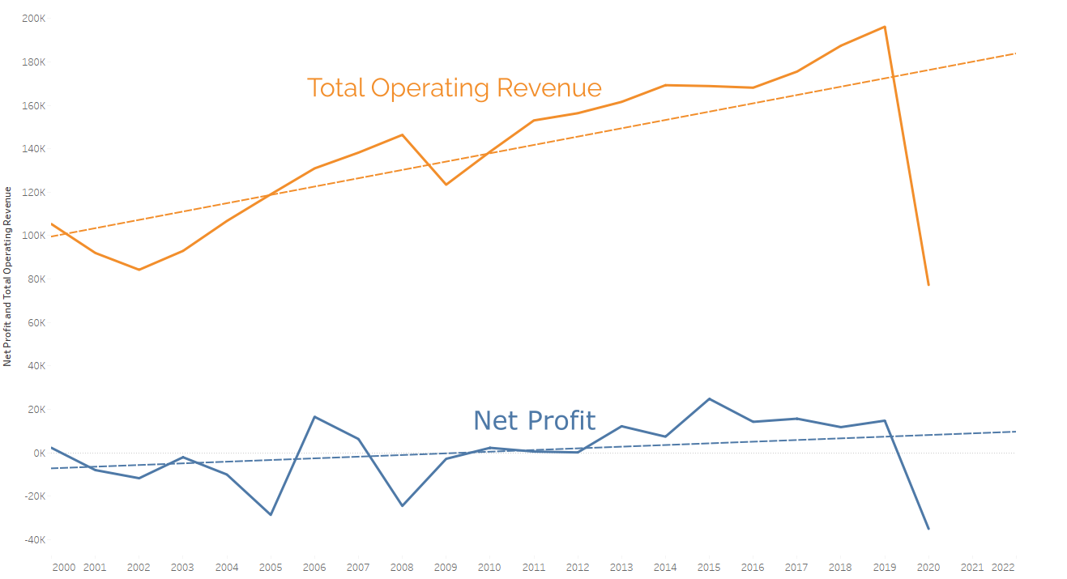
Net Profit and Total Operating Revenue 2000 - 2025

